Slide 1



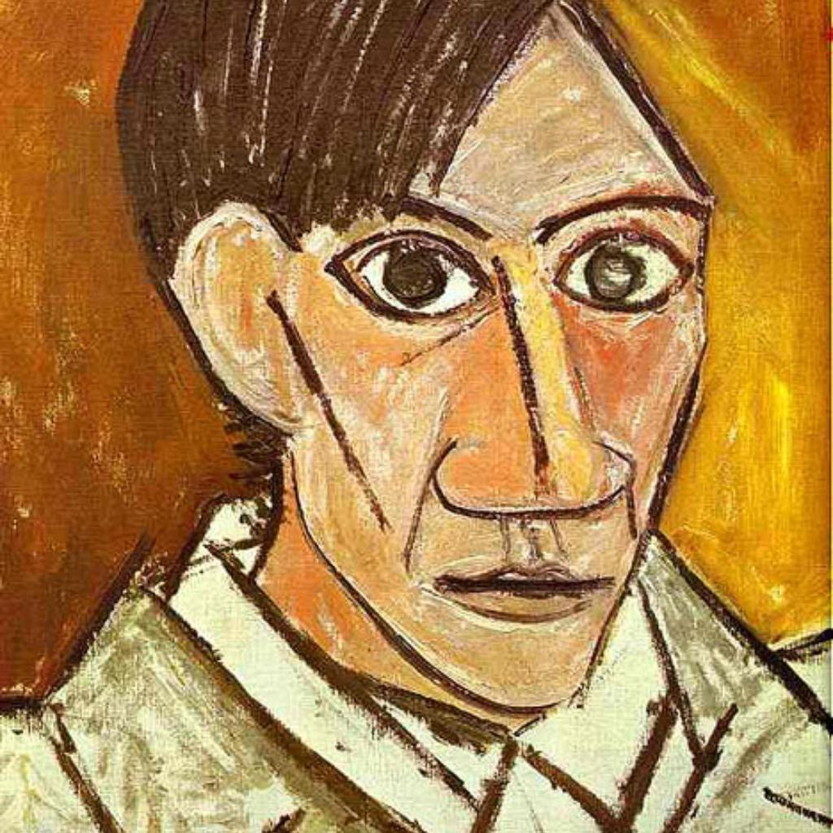
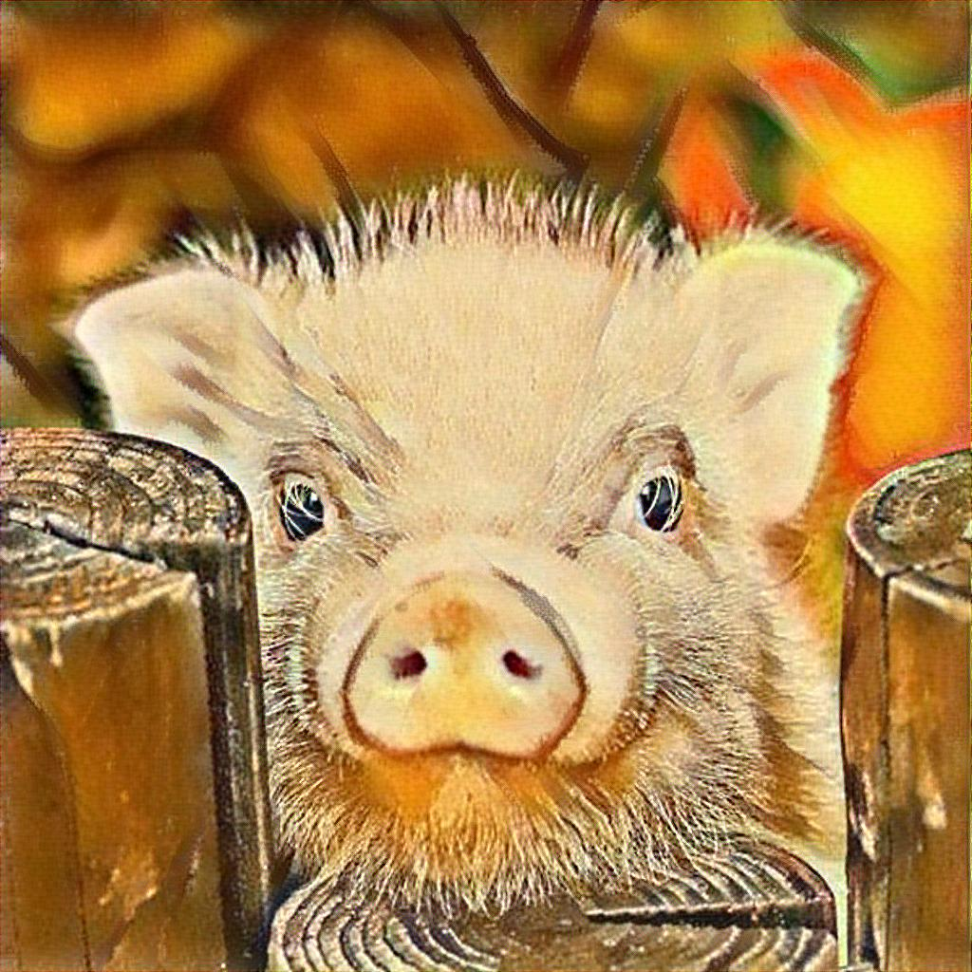
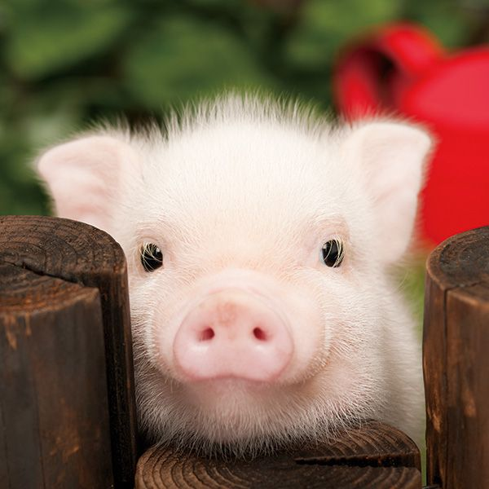
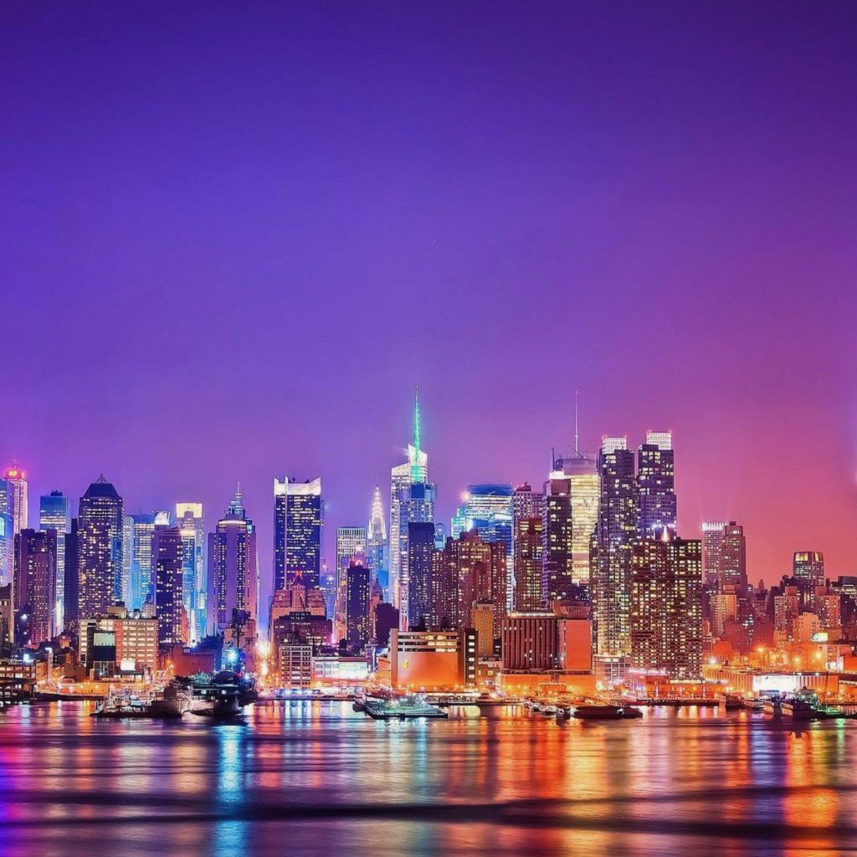
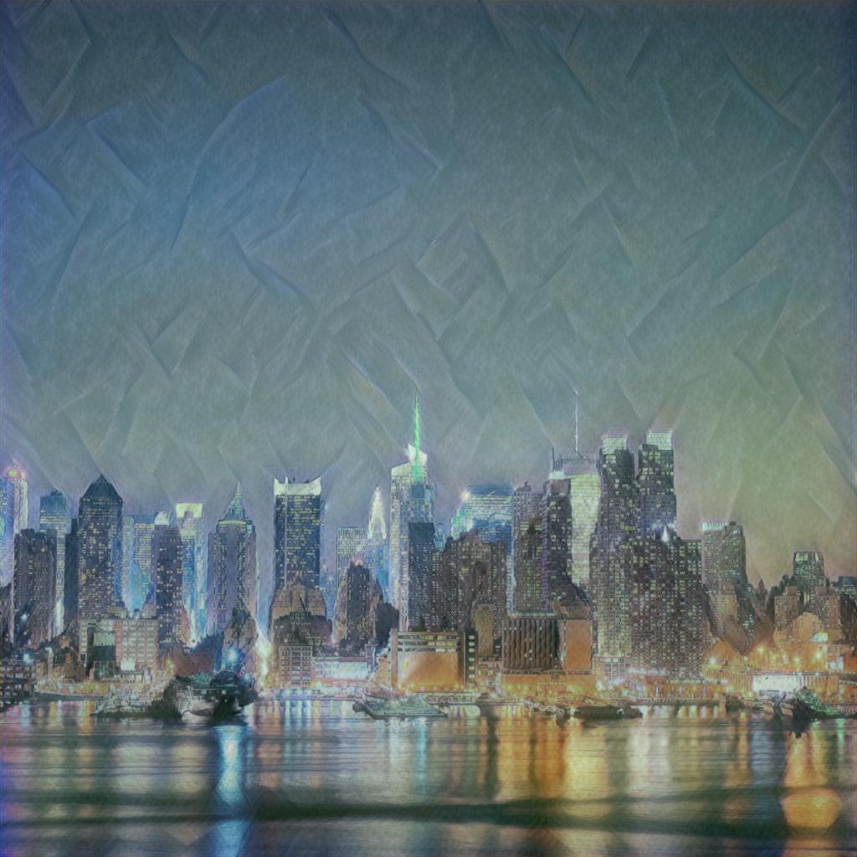
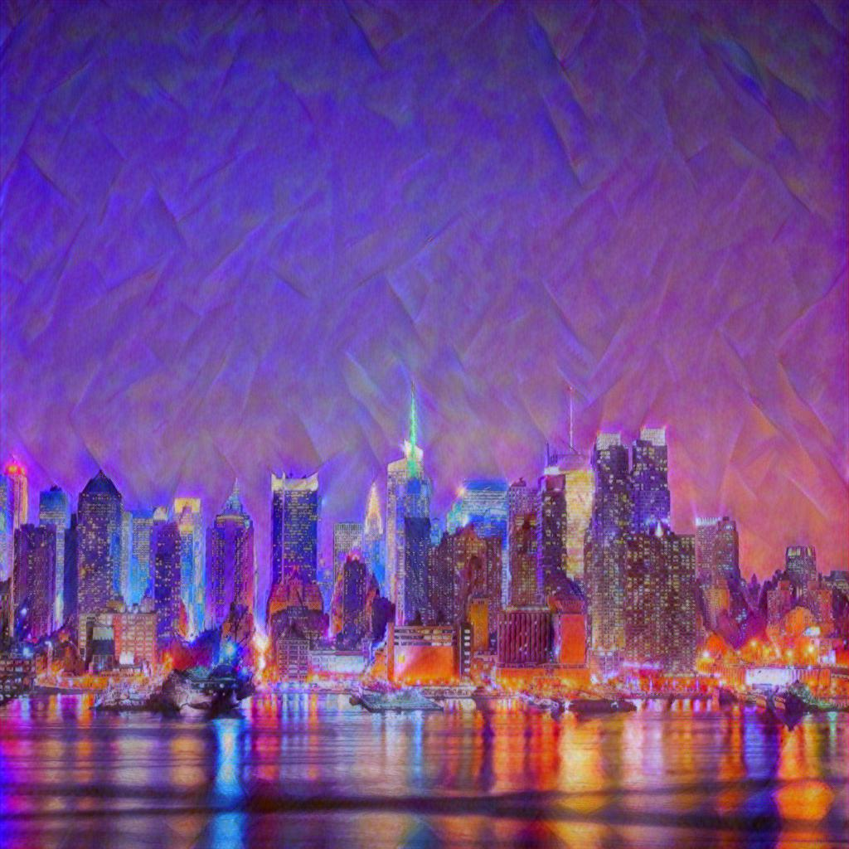
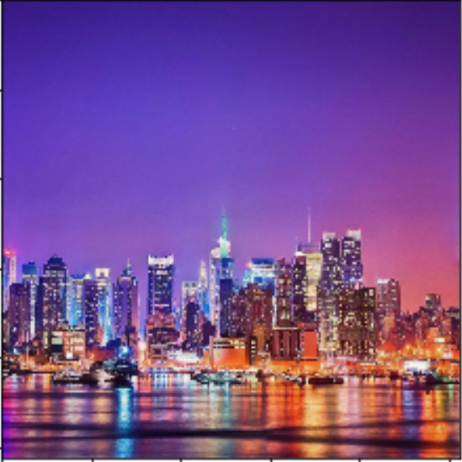
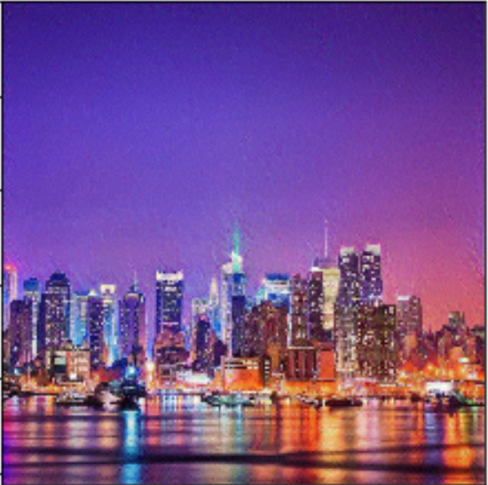
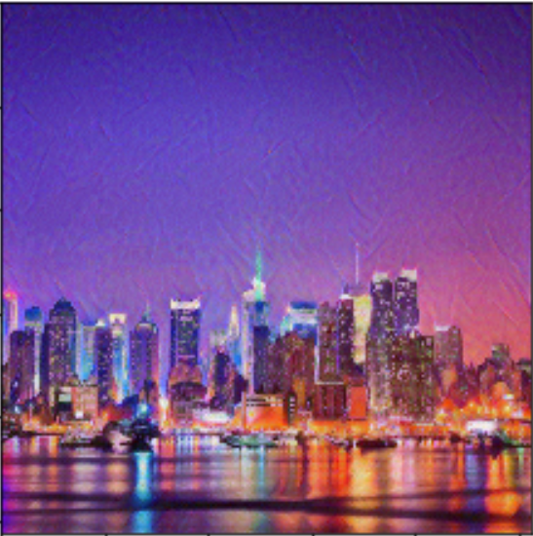
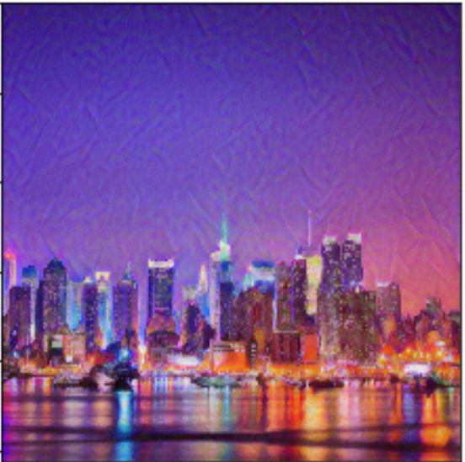
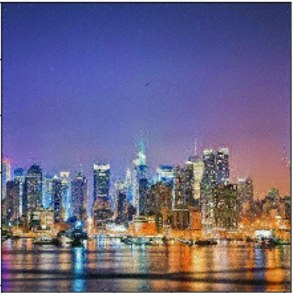
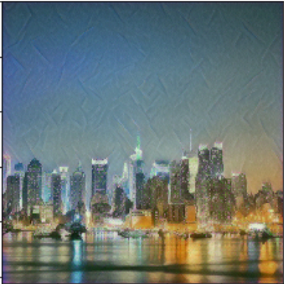
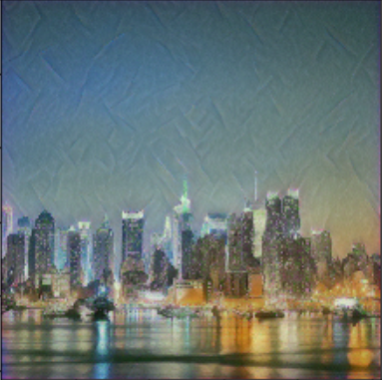
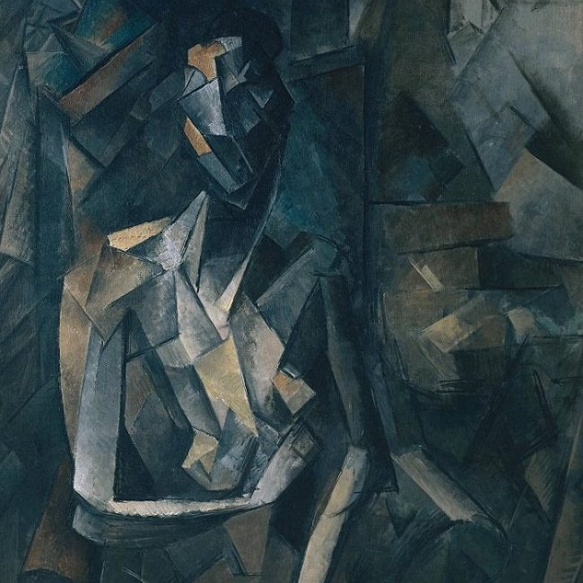
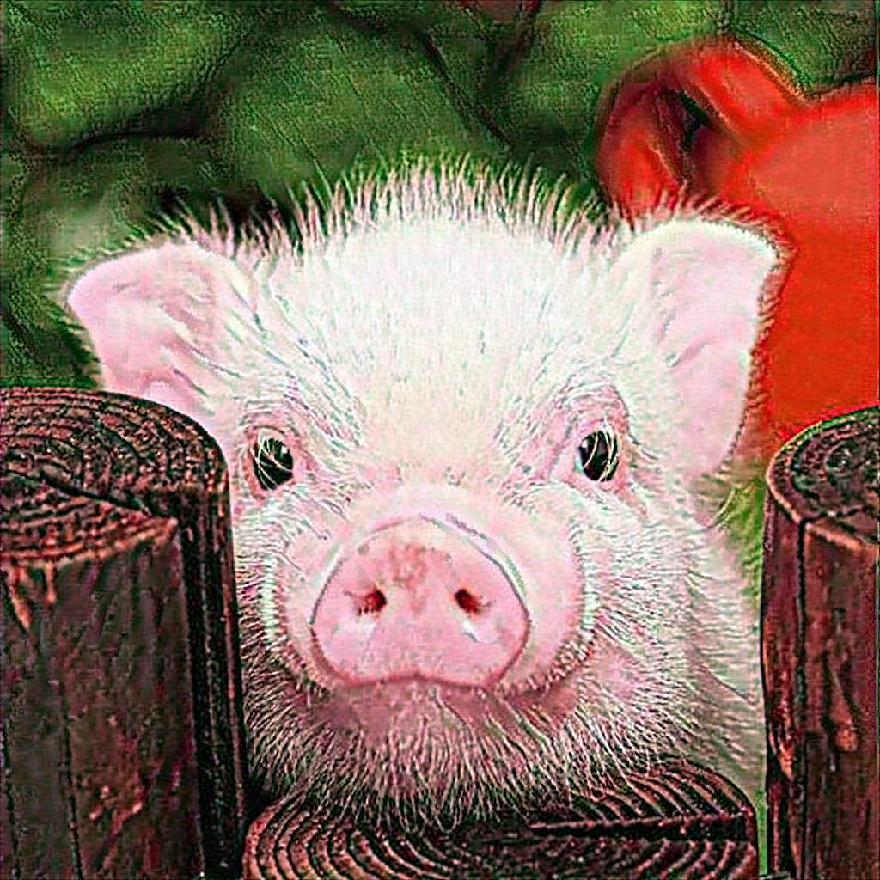

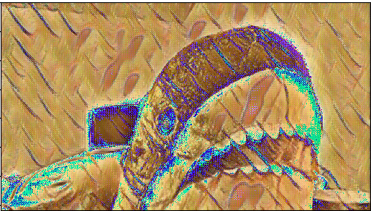


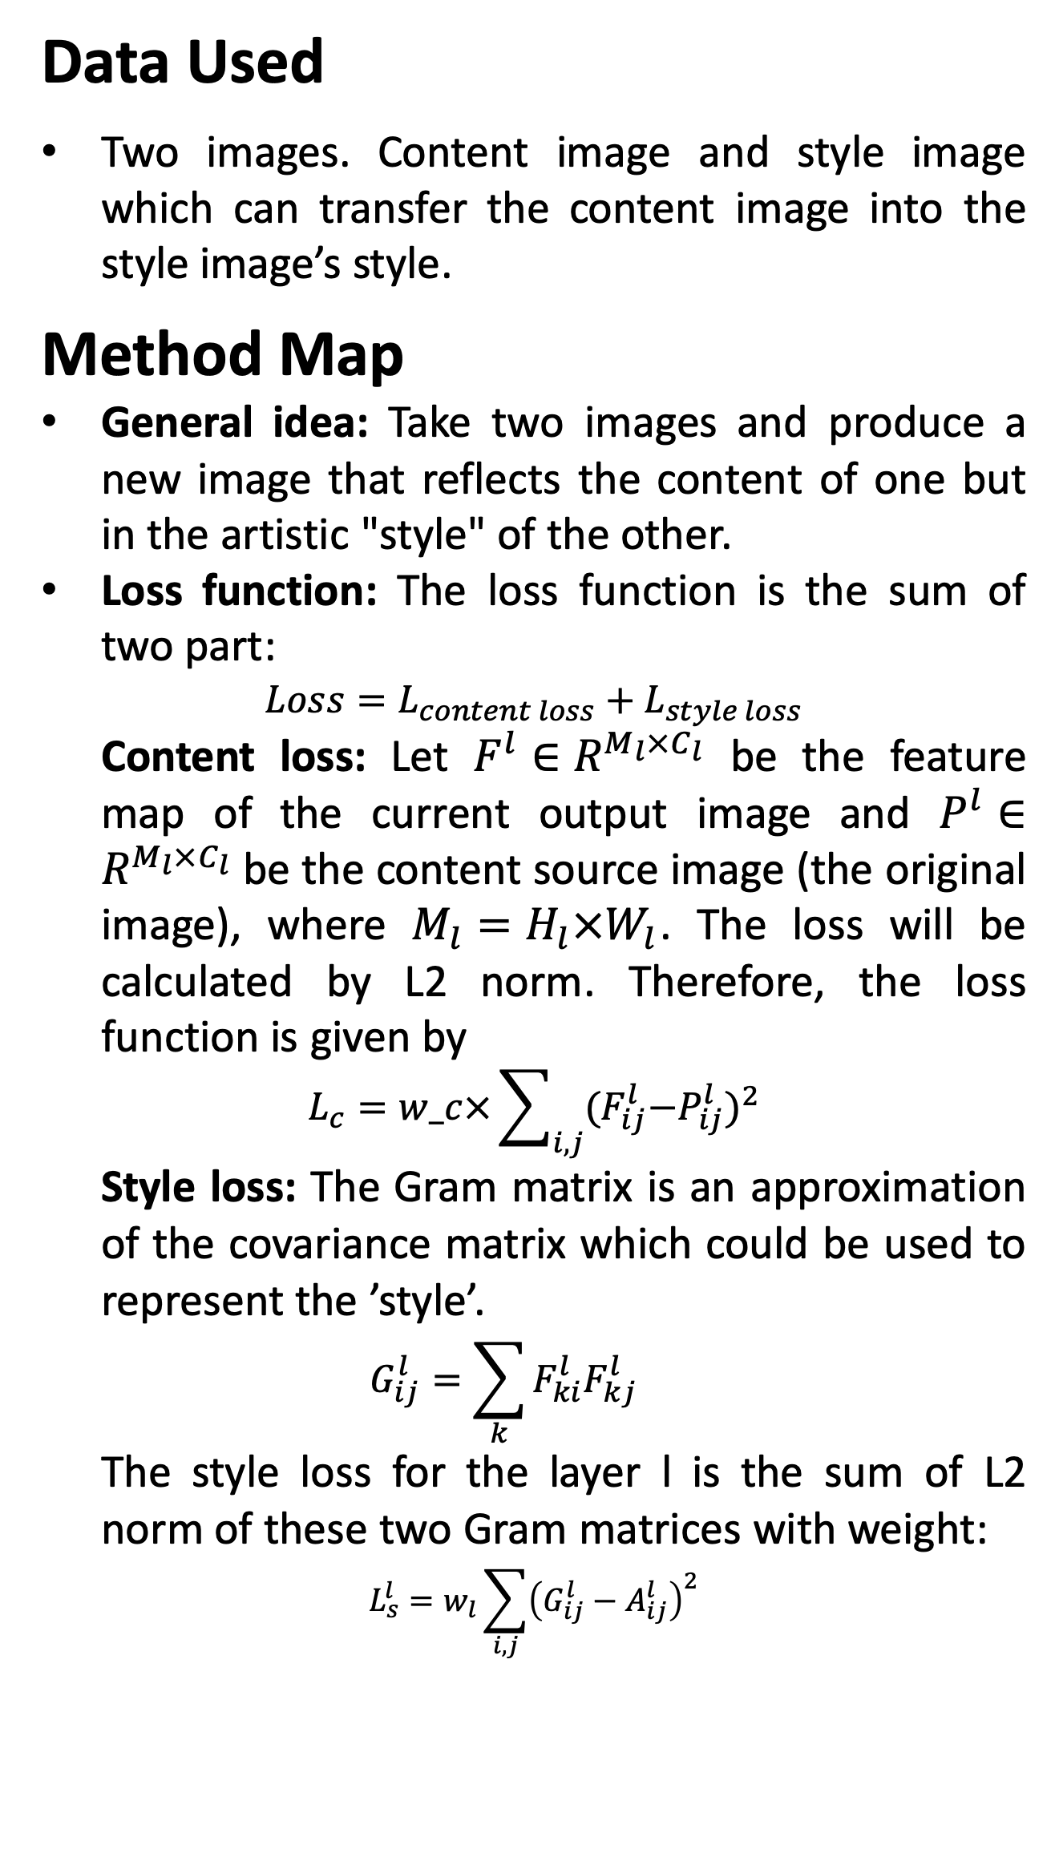
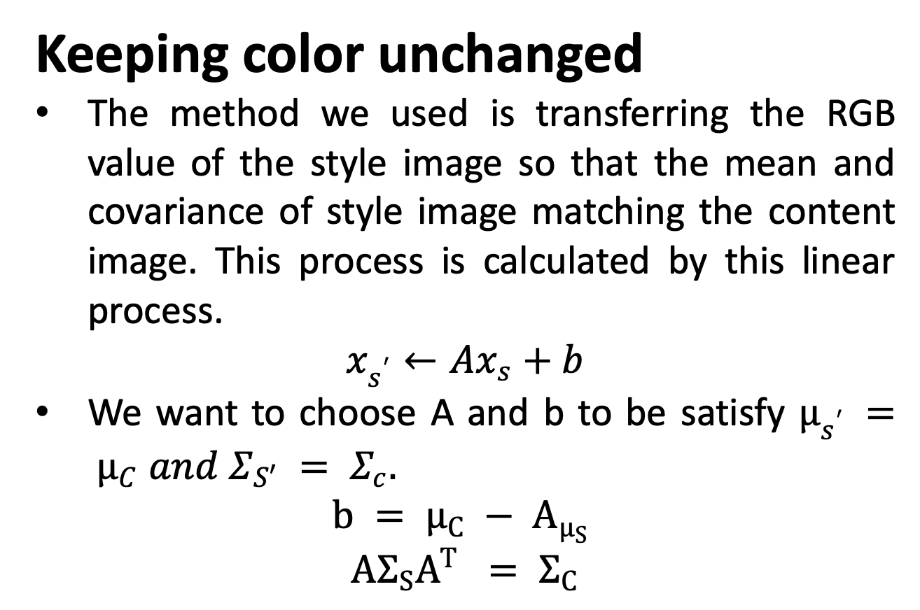
Neural Style Transfer
Junhao Zeng, Jingqiang Wang, Jinlin Xiang
Introduction
Keeping color unchanged
The method we used is transferring the RGB value of the style image so that the mean and covariance of style image matching the content image. This process is calculated by this linear process.
$$x_{s^{′}}←Ax_{s}+b$$
We want to choose A and b to be satisfy $µ_{s^{′}} = µ_{C} and Σ_{S′} = Σ_{c}.$
$$b = µ_{C} − A_{µ_{S}}$$
$$AΣ_{S}A^{T} = Σ_{C}$$
Content feature
Calculate loss
Content feature
Gradient Descent
Human artists usually master special painting skills to create a picture with a unique style, like oil painting, abstract painting and impressionist painting.
Our work is to transfer the style of one picture (content picture) according to a new given picture(style picture)
Appling convolution neural networks to transfer an image into feature map and generate new transferred image by optimizing the lose of style and content with gradient descent.
Color match
Style image
Pre-trained VGG19
LOSS
Pre-trained VGG19
Style feature
Style feature
Goal
content image
Calculate loss
Static Parameter
Train area
Method Map
Result
Conclusion
Data Used
Two images. Content image and style image which can transfer the content image into the style image’s style.
Method Map
General idea: Take two images and produce a new image that reflects the content of one but in the artistic "style" of the other.
Loss function: The loss function is the sum of two part:
$$Loss=L_{content loss}+L_{style loss}$$
Content loss: Let $F^{l}∈R^{M_{l}×C_{l}}$ be the feature map of the current output image and $P^{l}∈R^{M_{l}×C_{l}}$ be the content source image (the original image), where $M_{l}=H_{l}×W_{l}$. The loss will be calculated by L2 norm. Therefore, the loss function is given by
$$L_{c}=w_c×\sum_{i,j}{{{(F}_{ij}^{l}−P_{ij}^{l})}^{2}}$$
Style loss: The Gram matrix is an approximation of the covariance matrix which could be used to represent the ’style’.
$$G_{ij}^{l}=\sum_{k}{F_{ki}^{l}F_{kj}^{l}}$$
The style loss for the layer l is the sum of L2 norm of these two Gram matrices with weight:
$$L_{s}^{l}=w_{l}\sum_{i,j}{{\left(G_{ij}^{l}−A_{ij}^{l}\right)}^{2}}$$
All Neural Style Transfer:
Real-time style transfer:
Need to add networks between content image and pre-trained VGG19, and update networks parameter by the gradient descent as former one.
1. The style transfer algorithm performs an obvious changing on visual perspective. It demonstrates that the feature map got from the structure of CNN did represent the visual style of an image to a certain extent.
2. The color keeps unchanged after color retained algorithm.
3. The FNST take less time to compute the result, which is enough for an GXT1060 to generate a smooth transferred video.
Gradient Descent
Pre-trained VGG19
Add
Networks
Neural transformation without color changed:
Need to add color match function to transfer the style image color to content image color before calculating the style feature matrix.
Goal
Content
image
Train area
Future work
1. We could try to generate a segmentation result, which only make a specific part of the output to be transferred.
2. From the perspective of software, we could develop an application that could get the picture from user, and thus improve the experience of users.

